Slide 1
Introduction (TEAM 7)
Team 7 Name – Bug Buster
Rohit, Gauri, , Suheila, Digesh,Abhishek
Mentor : Prasad
Title: Quality Assurance Test Case Generation Agent
Problem statement: QA teams spend significant time creating test cases from requirements documents, which can delay testing and release cycles.
Objective of solution:
- Automate test case generation from requirement documents using AI.Generate relevant functional test scenarios efficiently.Enable users to review and customize generated test cases.Provide outputs in structured formats for easy integration.
Date: 12-SEP-2025

Slide 2
Problem context
Current QA Challenge
QA teams spend hours manually writing test cases
Delays release cycles
Risk of missing edge cases
Lack of standardization
Missing Industry specific Customization

Slide 3
Solution Considerations
1)Advanced Language Understanding:
ChatopenAI interprets complex requirements and extracts relevant test scenarios.
2)Coherent & Structured Output:
Generates clear, well-formatted test cases aligned with industry standards.
3)Adaptability & Customization:
Incorporates user preferences and domain-specific rules into test cases.
4)Error-Handling & Edge Case Coverage:
Creates tests for failures, validations, and unusual inputs often missed in manual efforts.

Slide 4
Solution Technicalities
ChatOpenAI Integration
State Management with LangGraph
Langchain Library
Flexible Output Format (JSON , Text formate)
Refine & Customize Capability
Error Handling & Edge Case Coverage.
Secure API Communication
Scalable Architecture

Slide 5
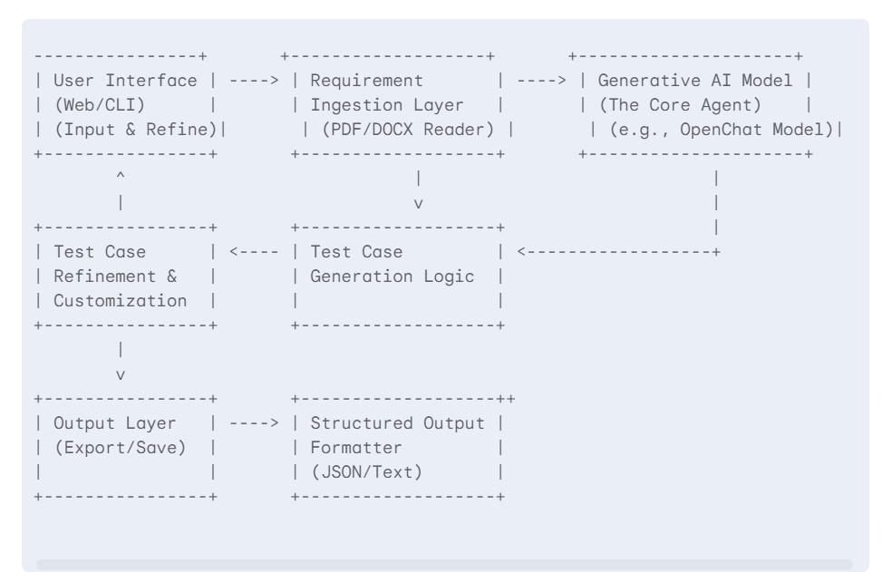
Flowchart

Slide 6
Presentation Layer: Streamlit UI (app.py)
• Logic Layer: LangGraph workflow (agent.py)
• Model Layer: LLMs (chatopenai)
• Storage: .env for keys, input.txt for samples
System Architecture and Tools

Slide 7
Live Demo

Slide 8
Results & Metrics
Results:
  Automated generation of human-readable and structured test cases from requirement documents.
  Supports both JSON and text formats for seamless integration with QA tools.
  Incorporates user preferences (edge cases, severity, enhancements) and industry best practices.
  Reduces time and effort required by QA teams for test case preparation.
  Ensures broader test coverage, including error handling and edge cases.

Slide 9
Results & Metrics
Metrics
  Test Case Generation Time: Reduced compared to manual creation.
  Accuracy: The generated cases aligned with expected scenarios (based on sample validations).
  Customization Rate: Users could tailor test cases with preferences effectively.
  Edge Case Inclusion: Automated inclusion in test cases where applicable.
  Format Compliance: Output structured in valid JSON or formatted text for direct use.
  User Satisfaction: positive feedback from initial pilot testers regarding ease of use and comprehensiveness.

Slide 10
Future Scope
Support for Multiple Models
Automated Test Case Validation
Enhanced Customization
Interactive Feedback Loop
Integration with CI/CD Pipelines

Slide 11
Conclusion
The Quality Assurance Test Case Generation Agent simplifies and accelerates test case creation by using ChatOpenAI, delivering structured, customizable outputs in JSON and text formats. It improves efficiency, ensures thorough coverage, and integrates easily with QA processes—helping teams test smarter and faster.

